Slide 1
Planing for DevOps

Slide 2
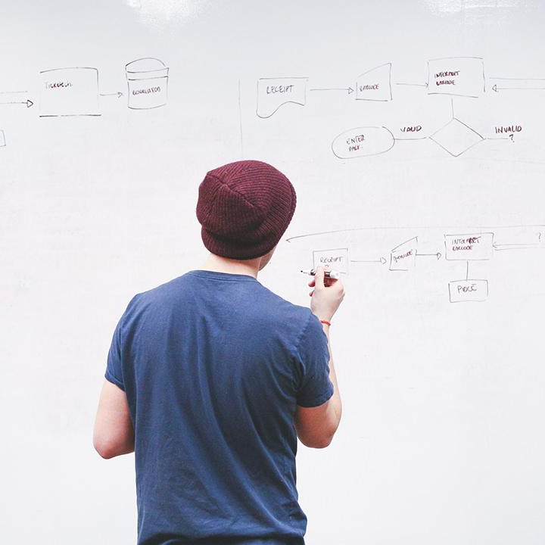
HELLO!
I am Eng Teong Cheah
Microsoft MVP
You can find me at @walkercet

Slide 3
Transformation Planning
1

Slide 4
What is DevOps
DevOps is the union of people, process, and products to enable continuous delivery of value to our end users.
DevOps is a continuous journey

Slide 5
Project Selection
2

Slide 6
Choosing Greenfield and Brownfield Projects
When starting a DevOps transformation, you might need to choose between Greenfield and Brownfield projects.
There is a common misconception that DevOps suits Greenfield projects better than Brownfield projects, but this is not the case.

Slide 7
Greenfield Projects
Always appears to be an easier starting point.
Because a blank state offers the chance to implement everything the way that you want.

Slide 8
Brownfield Projects
Comes with the baggage of existing code bases, existing teams, and often a great amount of technical debt
Spending time maintaining existing Brownfield applications, limits the ability to work on new code

Slide 9
Team Structures
3

Slide 10
Agile Development Practices Defined
Waterfall approach
Agile approach

Slide 11
Principles of Agile Development
1. Satisfy the customer
2. Welcome changing requirements
3. Deliver working software frequently
4. Work together throughout the project
5. Build projects around motivated individuals
6. Use face-to-face conversation

Slide 12
Principles of Agile Development
7. Measure progress through working software
8. Agile processes promote sustainable development
9. Continuous attention to technical excellence and good design
10. Simplicity--the art of maximizing the amount of work not done
11. Use self-organizing teams
12. Reflect on how to become more effective

Slide 13
Migrating to Azure DevOps
4

Slide 14
What can Azure Devops do?
Azure Boards
Azure Pipelines
Azure Repos
Azure Artifacts
Azure Test Plans

Slide 15
What if we are not a Microsoft / dotnet organization
Flexible
Cross Platform
Cloud Agnostic

Slide 16
What if we are not a Microsoft / dotnet organization
Flexible
Cross Platform
Cloud Agnostic

Slide 17
Migrating or Integrating Existing Work Management Tools
Trello integration tooling
Solidify

Slide 18
Migrating or Integrating ExistingTest Management Tools
Apache Jmeter
Pester
SoapUI

Slide 19
THANKS!
Any questions?
You can find me at
@walkercet

Slide 20
CREDITS
Microsoft Docs

